Slide 1


Redis or Memcached?
--Chunxiao Zhang
Netid: cz31

Slide 2
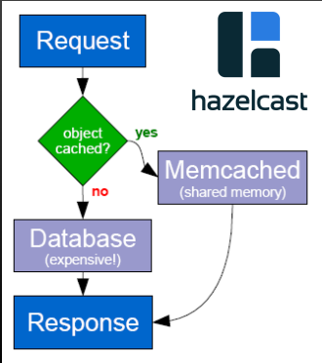
Why we need Redis or Memcached?
Answer:
Scaling
Scenario:
Login, Register, Search, Profile modification
Which has more operation requirement?
Read or Write?
Solution:
Caching

Slide 3

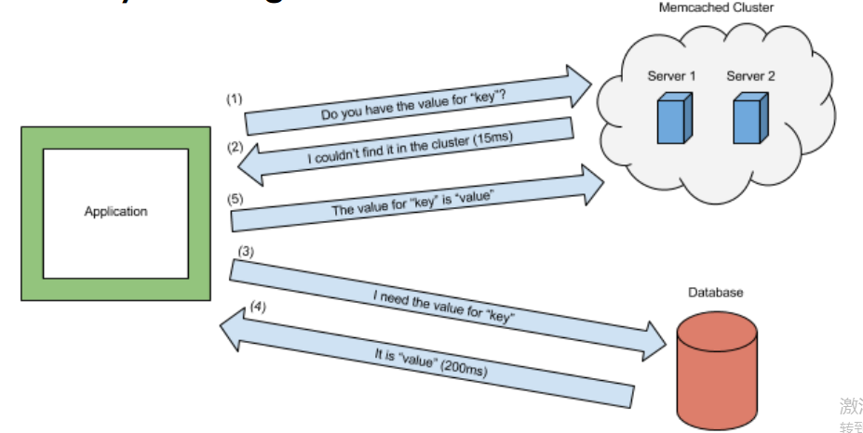
What is Memcached?
Volatile memory key-value database
Caching small chunks of data
(string or objects)

Slide 4
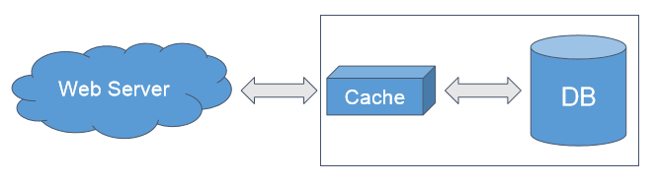
What is Redis?
REmote DIctionary Server
Data structure server
In memory dataset
Seven types of data structures:
Lists, sets, sorted sets, hashes, hyperloglogs, bitmaps
Can be persistence
Master-slave asynchronous replication

Slide 5
Commons:
NoSQL in-memory database
Provide high-performance in-memory database service
Store key-value mapping in memory

Slide 6
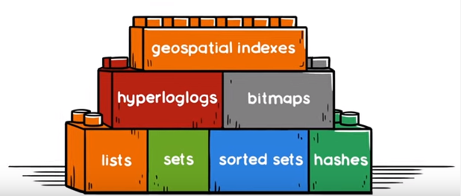
Differences --Storage:
Strings & Objects
VS
Memcached
Redis

Slide 7
Differences --Persistence:
Memcached: data stored in RAM, no persistence storage
VS
Redis: Provide persistence data storage by snapshot or AOF

Slide 8
Differences –Distributed system:
Memcached: Memcached itself does not support distributed system. Client needs to use consistent hash to realize Memcached distributed storage.
Redis: build the distributed system storage on the server side .

Slide 9
Redis or Memcached?

Slide 10
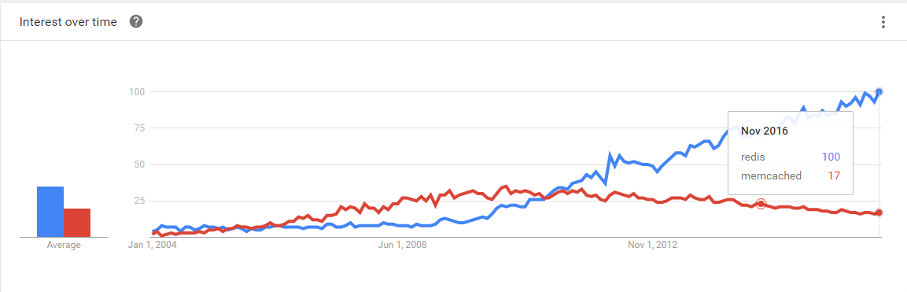
Notes:
No Synchronization

